Slide 1
Cognitive workload analysis of Control Room Operators using Electroencephalography(EEG) and Eye-tracking
Dr. Mohd Umair Iqbal
Research Associate
Department of Industrial and Systems Engineering
University of Wisconsin Madison
(mohammadumai@wisc.edu)
Dated: April 16, 2024. Tuesday

Slide 2
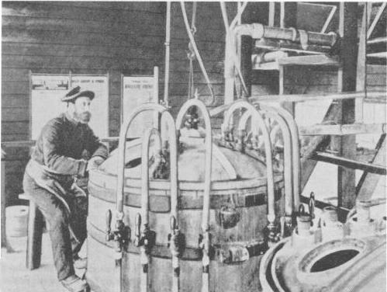
Safety in olden days
Nitroglycerine manufacture: Dangerous
Hazard: Wrong composition
Task:
Continuously watch a thermometer
Open a valve quickly to dump the whole batch to prevent an explosion
One-legged Stool!
https://www.austehc.unimelb.edu.au/tia/610_image.html

Slide 3
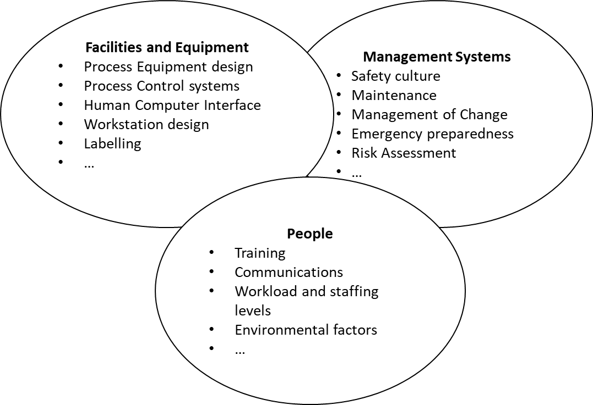
Human Factors
Top ten key issues in hazardous industries (HSE, 2022):
Managing Human Error
Training and Competence
Workload
…
Human factors (HF) is a scientific discipline that is concerned with the
understanding of interactions of people with other elements of the work system
in order to optimize their well-being and overall system performance (IEA Council, 2019)
Fig. A basic representation of human factors
IEA. (2021). Definitions, Domains of Specialization, Systemic Approach. https://iea.cc/definition-and-domains-of-ergonomics/
HSE (2022b). Introducing key topics. https://www.hse.gov.uk/humanfactors/top-ten.htm
Notes:
In the context of highly hazardous industries, the UK Health and Safety Executive identified the top issues as human failures, HF in design, procedures, organizational culture, organizational change, staffing, training and competence, safety-critical communications, fatigue and shift work, and finally, maintenance, inspection, and testing. The application of HF principles can help minimize risk. The reader is referred to HSE (2022b) for more details.

Slide 4
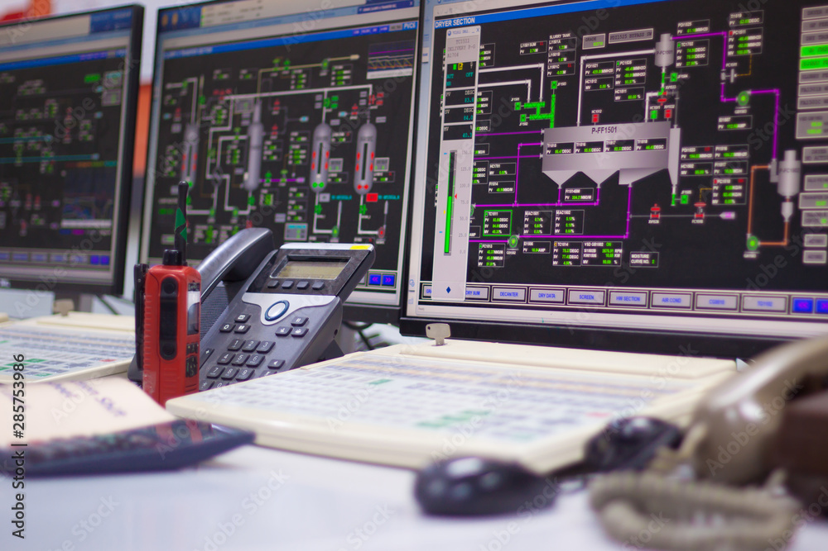
Nature of Human-Machine Interaction
Increasing complexity
Digitalization
Automation
Abundance of information
Shift in role
Operator often out of loop with the system
Fig. A typical industrial control room

Slide 5
Mental Models are critical for smooth operation
Mental Models:
Mapping of the properties of the task to its representation in the mind of the operator (Rasmussen, 1982, Moray, 1988).
Internal Feedback
Inputs
Perception
Interpretation
Reaction
Output
Feedback
Difficulties in Perception, interpretation and reaction can increase cognitive workload
and lead to mis-operation
Need for highly skilled operators and advanced performance assessment
Rasmussen, J., (1986). Information Processing and Human-Machine Interaction: an Approach to Cognitive Engineering. North-Holland, Amsterdam.
Moray, N., Lootsteen, P., & Pajak, J. (1986). Acquisition of process control skills. IEEE Transactions on Systems, Man, and Cybernetics, 16(4), 497-504.
Notes:
Casual Relationships within an equipment
Across equipment due to mass and energy balances
Due to Control structure
Need to operate in agile fashion to capture market and supply chain dynamics

Slide 6
Traditional Performance Assessment
Operator’s performance is assessed primarily in terms of:
Number of successes and failures
Response times
Deviation of operator actions from predefined sequence
Expert judgement
Cognitive aspects of performance often ignored
Eye-tracking and EEG
Insights into cognitive aspects of performance

Slide 7
Eye-tracking
Technique for monitoring the movements of the eyes of a person
Based on eye-mind hypothesis
Movement of eyes serves as a trace of attention allocation (Just and Carpenter, 1980)
Typical measurements:
Coordinates of gaze position
Diameter of pupil (pupillometry)
Just, M. A., & Carpenter, P. A. (1980). A theory of reading: From eye fixations to comprehension. Psychological review, 87(4), 329.

Slide 8
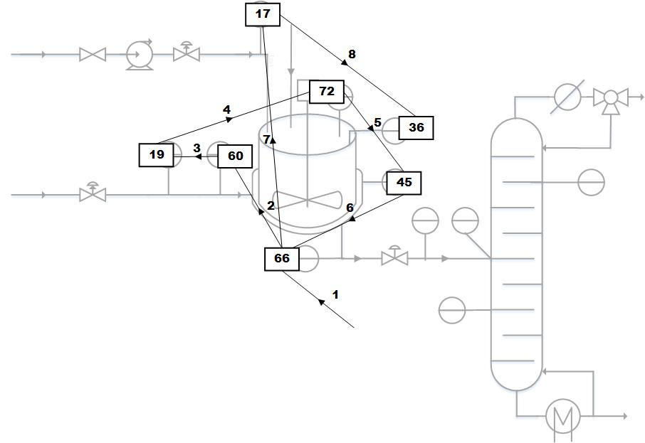
Eye Gaze Movement
210
Fixation: Period during which the eye is relatively still (200-300 ms)
227
213
262
280
236
255
Saccade: Quick eye movements between fixations (30-80 ms)
Peak saccadic velocity: Highest velocity reached during a saccade
Velocity
time

Slide 9
Eye tracking based insights
Pupil diameter is a marker of control room operator’s workload (Bhavsar et al., 2016)
Eye gaze pattern of some participants who are successful in controlling a disturbance resemble failure groups (Sharma et al., 2016)
Eye gaze entropy can differentiate expert and novice operators (Bhavsar et al., 2017)
Eye tracking metrics such as fixation duration and saccade duration can reveal information about evolution of cognitive states (Das et al., 2018)
Bhavsar, P., Srinivasan, B., & Srinivasan, R. (2016). Pupillometry based real-time monitoring of operator’s cognitive workload to prevent human error during abnormal situations.
Sharma, C., Bhavsar, P., Srinivasan, B., & Srinivasan, R. (2016). Eye gaze movement studies of control room operators: A novel approach to improve process safety.
Bhavsar, P., Srinivasan, B., & Srinivasan, R. (2017). Quantifying situation awareness of control room operators using eye-gaze behavior.
Das, L., Iqbal, M. U., Bhavsar, P., Srinivasan, B., & Srinivasan, R. (2018). Toward preventing accidents in process industries by inferring the cognitive state of control room operators through eye tracking.

Slide 10
Entropy: A measure of Learning
An eye-tracking based study

Slide 11
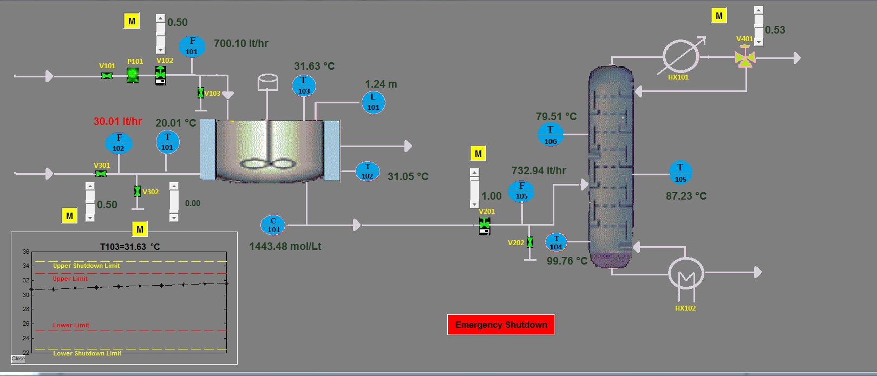
Experimental Protocol
Experimental subjects:
5 graduate students of chemical engineering
Instructions
Instruction manual and video on how to operate the plant.
Task
Bring the process variables to within acceptable limits if a disturbance occurred
Fig. HMI of the ethanol process with which the operators interact

Slide 12
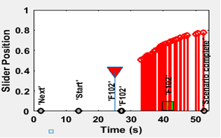
Typical Task
Operator monitors the process
Alarm gets triggered to alert the operator
Operator takes action in terms of slider movement
Scenario completion or shutdown
Fig. 5: Slider position trend with time

Slide 13
Nature of the tasks
Task No. | Disturbance | Corrective Action
1 | Coolant flow rate | Move coolant slider to appropriate position
2 | Coolant flow rate and coolant valve getting stuck | Identify bypass valve, and use it to maintain coolant flow rate

Slide 14
Entropy: First alarm to first slider action
Fig. Comparative gaze entropy for different participants from first alarm to first slider action
Increase in entropy reflects exploration by the operators to find an alternative to the stuck valve
Notes:
Tries to find an alternative when slider gets stuck during task 2, that results in increase in entropy

Slide 15
Entropy: First slider to last slider action
Fig. Comparative gaze entropy for different participants from first slider to last slider action
Once the slider is identified, operator knows the effect of moving the slider and doesn’t look at other sliders. Hence entropy decreases during the second repetitive task.
Notes:
Once the slider is identified, operator knows the effect of moving the slider and doesn’t look at other sliders. Hence entropy decreases during the second repetitive task.

Slide 16
Summary
Decrease in entropy
Reflects learning of a participant
Change in mental state : ‘more entropy’ to ‘less entropy’
Decrease in cognitive workload
Relative relief of the working memory load due to compensation from prior belief/learning
Notes:
(Joseph, 2013)

Slide 17
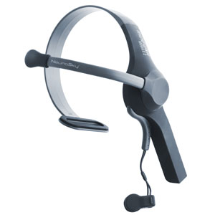
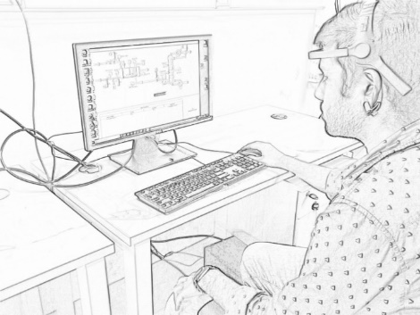
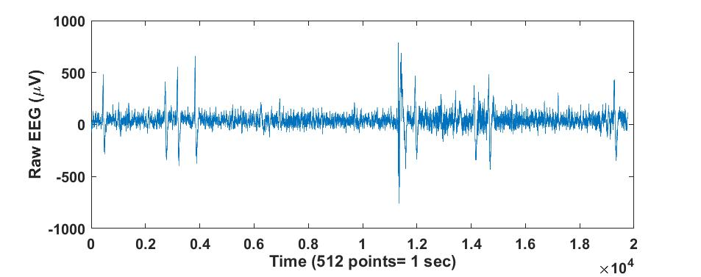
Electroencephalography (EEG)
EEG is the recording of the electrical activity (in microvolts) on the scalp, by placement of electrodes/sensors
Fig. A single electrode EEG device (Neurosky)
Fig. An operator wearing an EEG device
Fig. A sample of raw EEG data
EEG signal is often analysed in frequency domain
Commonly analysed bands:
Delta(1- 3Hz), Theta (4- 7 Hz), Alpha(8- 13 Hz), Beta (14- 30 Hz)
http://neurosky.com/
17

Slide 18
Dynamic assessment of mental model mismatches and cognitive workload
Based on the power spectral density of Theta band (4 – 7 Hz)

Slide 19
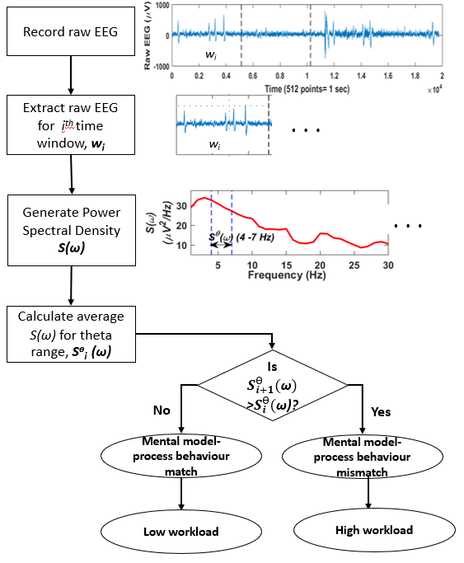
Methodology

Slide 20
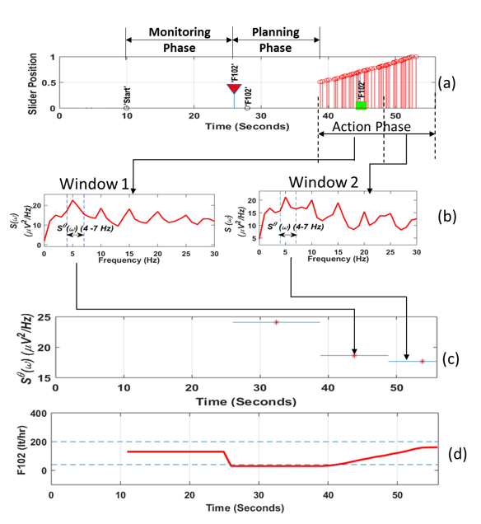
Illustrative Example 1
Decrease in theta power spectral density indicates mental model-process behaviour match

Slide 21
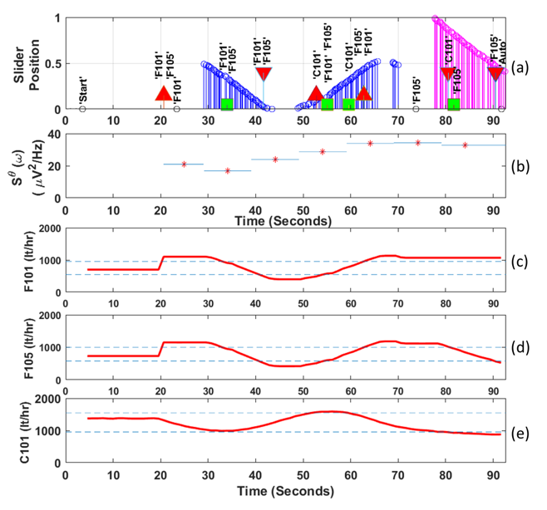
Illustrative Example 2
Increase in theta power spectral density indicates mental model-process behaviour mismatch

Slide 22
Summary
Delta power spectral density can capture cognitive workload changes during a task
High values of delta power spectral density represent high workload
Identify high workload instances/tasks

Slide 23
Training assessment using EEG
A clustering based approach based on power spectral densities in the range of
1-30 Hz

Slide 24
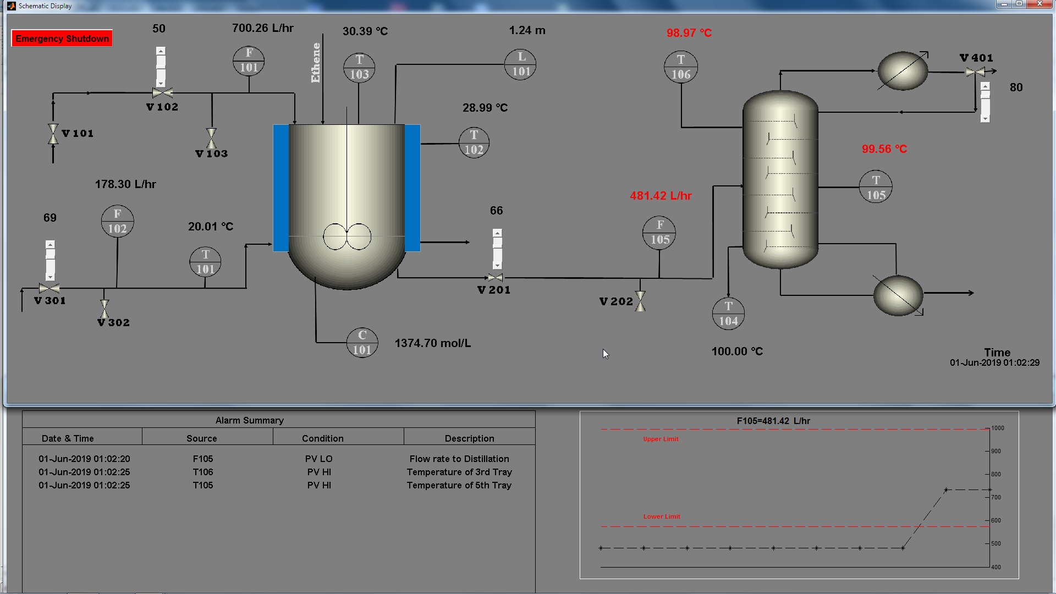
Experimental Study
Fig. HMI of the ethanol production plant
Trials: 7-8 trials performed by each participant resulting in a total of 438 tasks

Slide 25
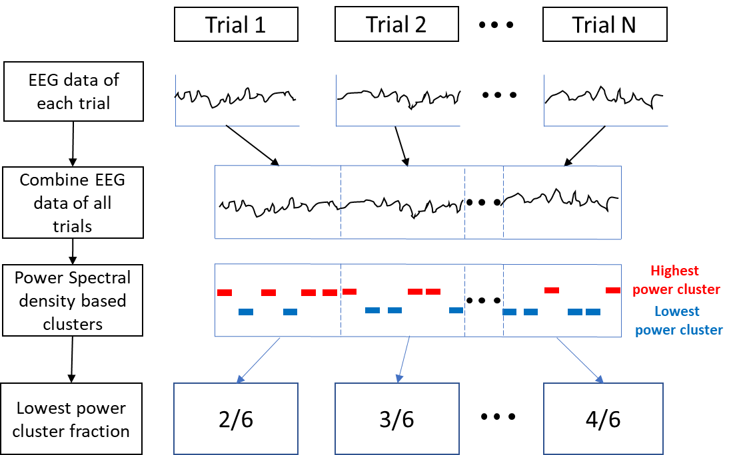
Schematic of the Methodology
Fig. Simplified proposed methodology
High
Better cognitive performance
Fraction of time during which operator is in
low power cluster
Low
Poor cognitive performance

Slide 26
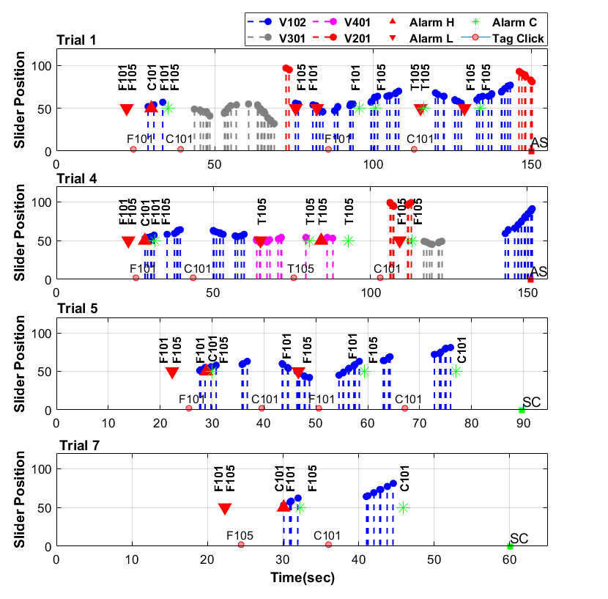
Illustrative Example 1
Operator uses multiple sliders reflecting the inability to understand the process behaviour, and it results in failure
Tries multiple sliders initially but identifies the correct slider towards the end, still fails
Learns the direction of the correct slider, and succeeds to clear all the alarms
Operator resorts to the smooth movement of the slider, and takes lesser time (45s) to clear the alarm, thus showing expert behavior
Fig. Operator behaviour and alarm occurrences during different trials.

Slide 27
Process and Behavioural Metrics
Fig. Process and behavioural metrics during different trials of an operator

Slide 28
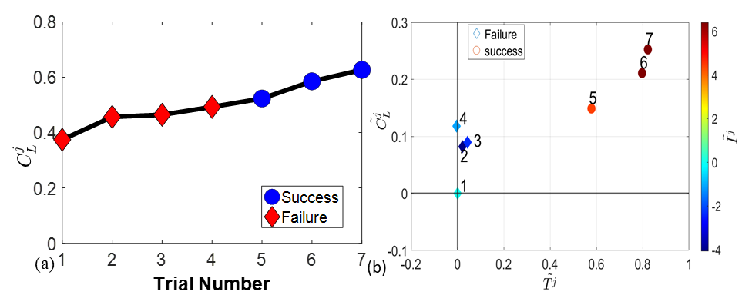
Cognitive Metric
$C_{L}^{j}$is lower for failure trials compared to successful trials
Difference in cluster fraction ($\tilde{C_{L}})$, time ($\tilde{T})$and integral absolute abnormality ($\tilde{I}$) also show improvement
Increase in low energy cluster fraction represents decrease in cognitive workload
Decrease in cognitive workload reflects improvement in cognitive performance

Slide 29
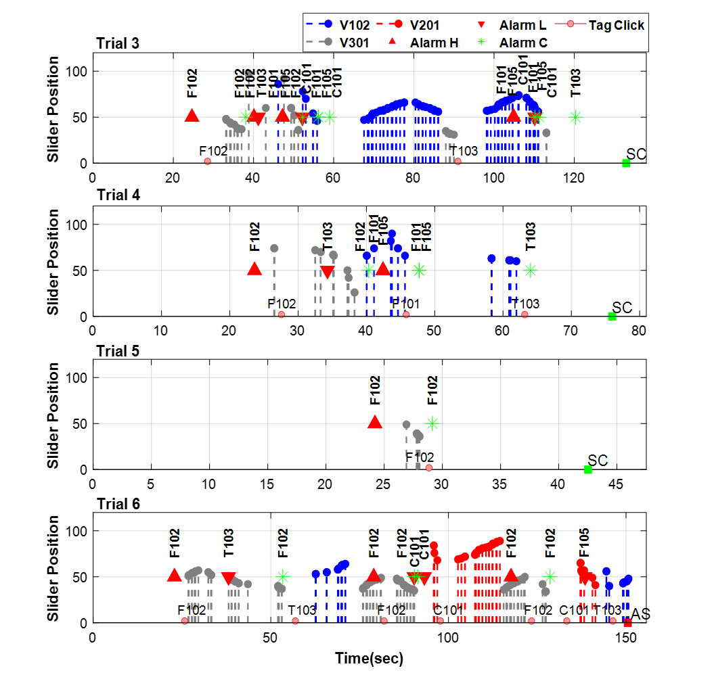
Illustrative Example 2
Operator uses two sliders reflecting the difficulty in understanding the process behaviour, but somehow manages to clear all alarms
Operator starts with the correct slider but moves it in wrong direction initially, and then also plays with another slider
Operator uses the correct slider to clear the alarm, but has he really learned?
Operator starts with the correct slider but moves it in wrong direction, and then resorts to the use of multiple sliders
Fails to clear the alarms which he had cleared in previous trials
Fig. Operator behaviour and alarm occurrences during different trials.

Slide 30
Cognitive Metric
From trials 3 to 5, the operator clears all the alarms, but his cognitive workload is still increasing (as reflected by decrease in $C_{L}^{j}$)
In trial 6, the operator surprisingly fails, reflecting possible absence of complete learning during the previous trials
High energy cluster fraction can capture absence of learning

Slide 31
Summary
Novice operator
Instructor/automated system
Operator training
Skilled operators
Physiological measurement
Cognitive behavior based data analytics
Advanced Training assessment for improved safety
Paves way for designing individual-centric training programs

Slide 32
Multi-class classification of control room operators’ cognitive workload using the fusion of eye-tracking and electroencephalography
A machine learning based approach to estimate cognitive workload of operators at three levels

Slide 33
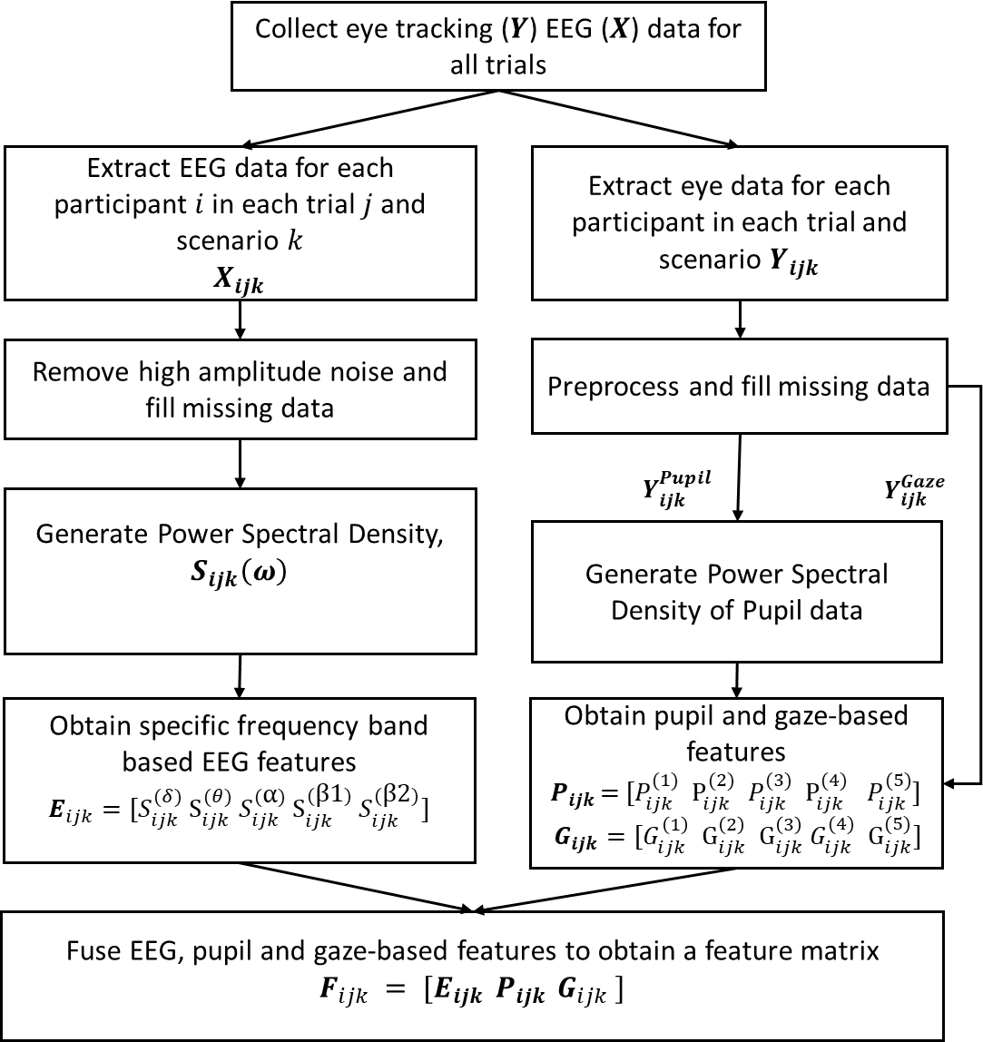
Proposed Methodology

Slide 34
Basis for Cognitive workload labels
Control room operator tasks are highly dynamic, and the perception of cognitive workload is highly challenging
Feedback-based cognitive workload assessment is prone to bias
Integral absolute abnormality (IAA)
Measures the deviation of process variables from alarm limits over a time period
High IAA often associated with failure to control an abnormality
IAA decreases with increase in expertise (Iqbal et al., 2021, Shahab et al., 2022)
Iqbal, M. U., Shahab, M. A., Choudhary, M., Srinivasan, B., & Srinivasan, R. (2021). Electroencephalography (EEG) based cognitive measures for evaluating the effectiveness of operator training. PSEP.
Shahab, M. A., Iqbal, M. U., Srinivasan, B., & Srinivasan, R. (2021). Metrics for objectively assessing operator training using eye gaze patterns. PSEP.

Slide 35
Summary of Feature Categories
S. NO. | Feature Category | Feature Description
1 | Pupil | P1: PSD of pupil diameter signal in the range of 0 – 0.5Hz P2: PSD of pupil diameter signal in the range of 0.5 – 1 Hz P3: PSD of pupil diameter signal in the range of 1 – 1.5 Hz P4: PSD of pupil diameter signal in the range of 1.5 – 2 Hz P5: Average pupil diameter
2 | EEG | δ: PSD of EEG signal in the range of 1 – 3 Hz θ: PSD of EEG signal in the range of 4 – 7 Hz α: PSD of EEG signal in the range of 8 – 13 Hz β1: PSD of EEG signal in the range of 14 – 20 Hz β2: PSD of EEG signal in the range of 21– 30 Hz
3 | Gaze | G1: Longest Fixation duration/shortest Fixation duration G2: Normalized Fixation Number, i.e., No. of fixations/time G3: Normalized Fixation Duration: Total fixation duration/time G4: Standard deviation of fixation duration G5: Mean of fixation duration

Slide 36
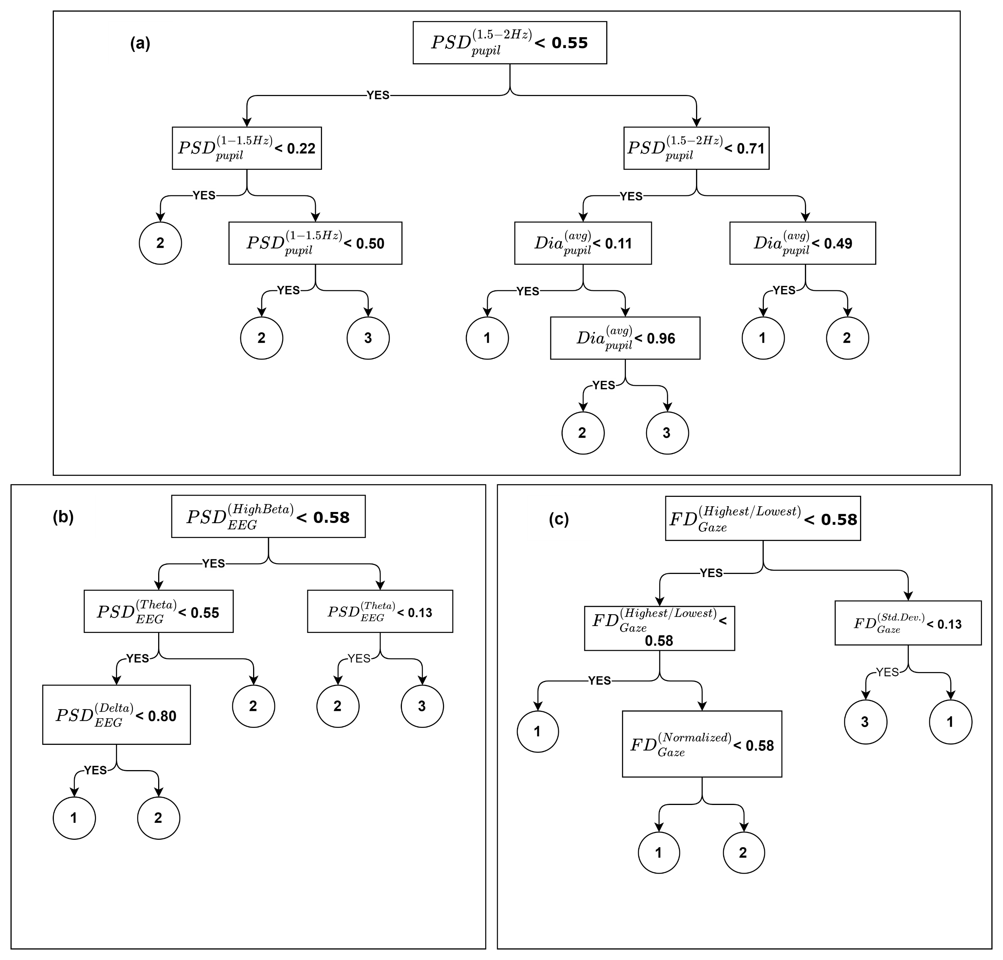
Decision Trees: Pupil, EEG and Gaze Based
1- Low cognitive workload 2- Medium cognitive workload
3- High cognitive workload
Fig. a) Confusion matrices for three levels of cognitive workload obtained using a) pupil-based features b) EEG based features c) Gaze based features
Fig. a) Decision tree for operator O4 trained using a) pupil-based features b) EEG based features c) Gaze based features

Slide 37
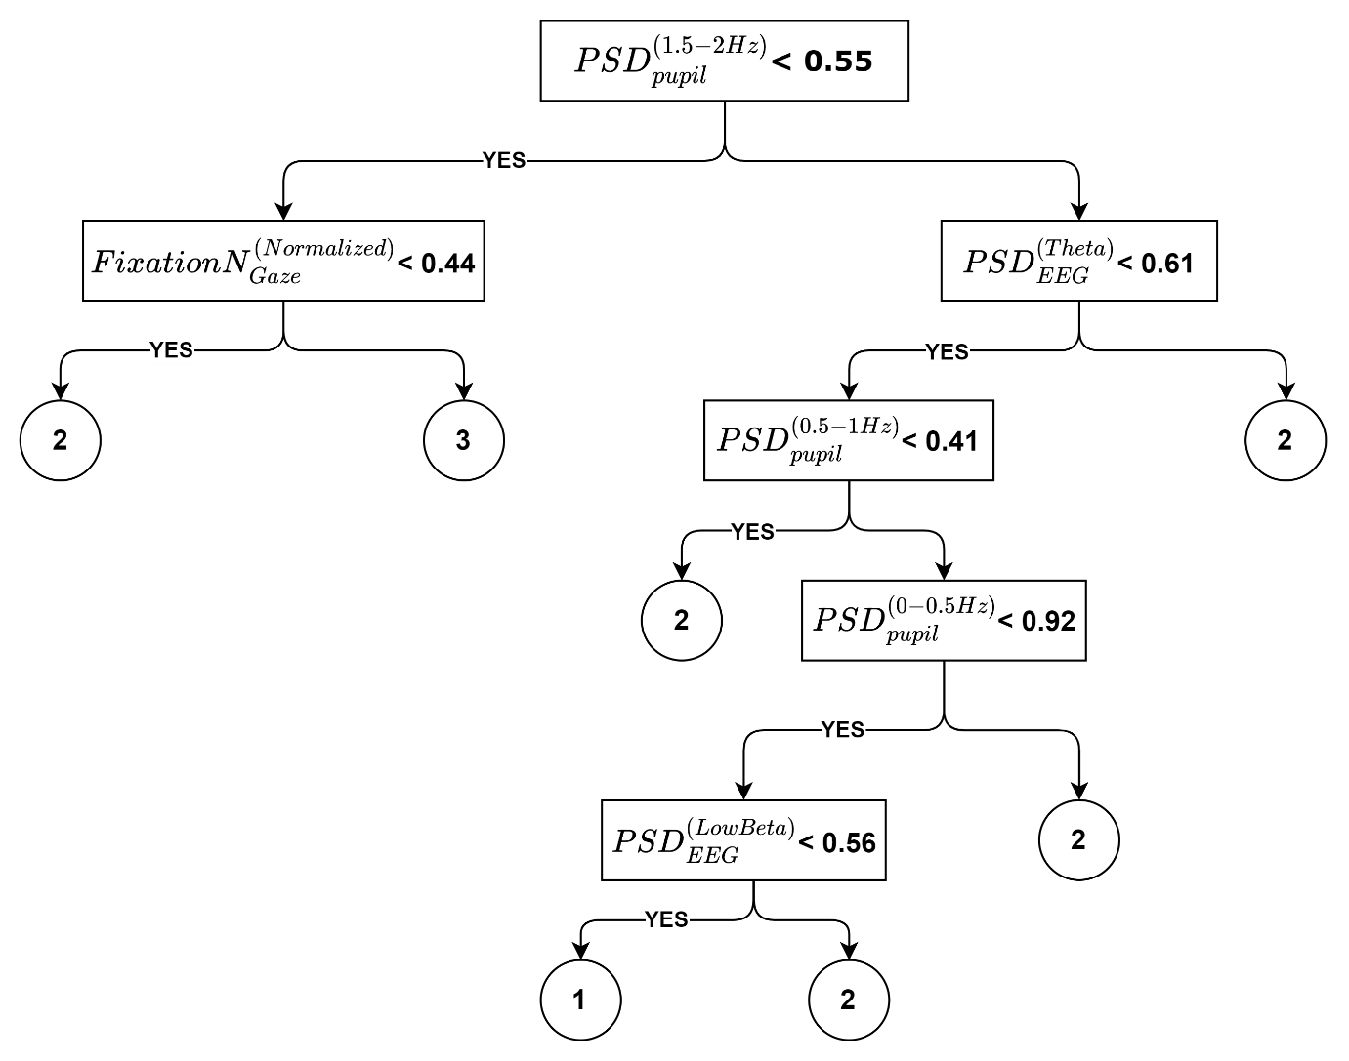
Fusion of Features
1- Low cognitive workload 2- Medium cognitive workload
3- High cognitive workload
Fig. Decision tree for operator O4 trained on the fusion of pupil, EEG, and gaze-based features
Fig. a) Confusion matrices for three levels of cognitive workload obtained using fusion of pupil-based, EEG-based and gaze based features

Slide 38
Result Summary
S. NO. | Feature Combination | Overall accuracy (%)
1 | Pupil only | 60.87
2 | EEG only | 45.65
3 | Gaze only | 50.00
4 | Pupil + EEG | 63.04
5 | Pupil + Gaze | 65.22
6 | EEG + Gaze | 39.13
7 | Pupil +EEG + Gaze | 69.56
Aygun et al. (2022) report a three-level cognitive workload mean classification accuracy of 51.59% using pupil-based features in a driving task.
Braarud et al. (2020) report a workload classification accuracy of 63% based on speech features. (Nuclear domain)
Operator O4: Fusion of features results in increase in accuracy of workload classification

Slide 39
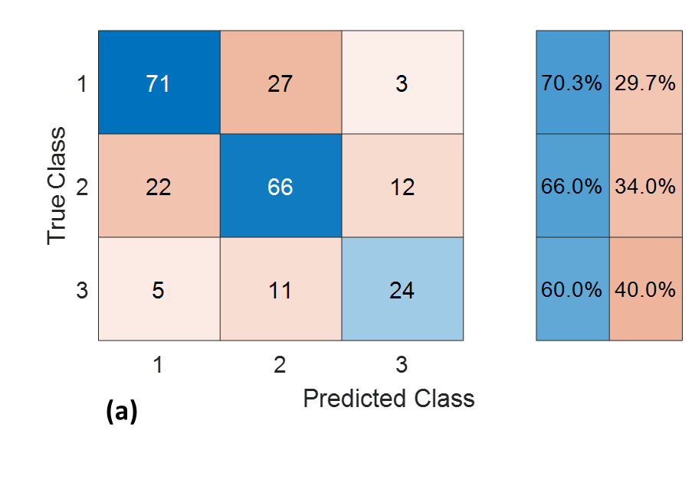
Population Model
1- Low cognitive workload 2- Medium cognitive workload
3- High cognitive workload
S. NO. | Feature Combination | Overall accuracy (%)
1 | Pupil only | 54.35
2 | EEG only | 50.20
3 | Gaze only | 50.62
4 | Pupil + EEG | 63.90
5 | Pupil + Gaze | 63.07
6 | EEG + Gaze | 52.28
7 | Pupil +EEG + Gaze | 66.80
Fig. Confusion matrices for population-level decision trees trained using all features for 3-level workload classification
Braarud et al. (2021) have reported a mean accuracy of 59% for a generalized model of workload that can be applied to nuclear power plant operators.
Fusion of sensors improves cognitive workload classification accuracies at population level
Notes:
Braarud, P. Ø., Bodal, T., Hulsund, J. E., Louka, M. N., Nihlwing, C., Nystad, E., ... & Wingstedt, E. (2021). An investigation of speech features, plant system Alarms, and operator–system interaction for the classification of operator cognitive workload during dynamic work. Human factors, 63(5), 736-756.

Slide 40
Fusion improves class-wise accuracies
Table . Population-level model accuracies for multi-level workload classification (Class-wise)
Label Category (Workload Class) | Pupil Only (%) | EEG Only (%) | Gaze Only (%) | Pupil + EEG (%) | Pupil + Gaze (%) | EEG + Gaze (%) | Pupil + EEG + Gaze (%)
1 | 64.4 | 55.4 | 47.5 | 67.3 | 70.3 | 51.5 | 70.3
2 | 54.0 | 54.0 | 53.0 | 62.0 | 59.0 | 52.0 | 66.0
3 | 30.0 | 27.5 | 52.5 | 60.0 | 55.0 | 55.0 | 60.0

Slide 41
Conclusions
Cognitive demands are more relevant than ever
Push towards digitalization and automation
Advent of Industry 5.0
Fusion of different variety of features results in an increase in cognitive workload classification accuracy
Reflects advances in cognitive performance assessment
Can be used to develop sophisticated training assessment platforms for process industry
Improved assessment translates to improved safety
Current work has the potential to guide application of human factors in process industries

Slide 42
Future Work
Integrate multiple sensors for more robust performance evaluation
Different sensors capture different aspects of cognitive workload. For instance, Eye tracking (visual aspects of workload), EEG (Neural aspects)
Identify and evaluate precursors to sub-optimal performance which include fatigue and engagement levels
Relevant during long-working hours
Evaluate and improve HMI design for enhancing the efficiency of interaction between operators and machines
Understand dynamic Human-Machine collaboration

Slide 43
Future Work Contd…
Develop adaptive training protocols based on mental state of operators
Adaptive training increases pace of learning (Chaouachi et al., 2019)
Study cognitive workload during team interactions
Develop cognitively aware computing systems for communicating user state
Evaluate the effectiveness of virtual reality based training (Srinivasan et al., 2022)
Develop systematic methodology to guide human factor specialists
Chaouachi, M., Jraidi, I., Lajoie, S. P., & Frasson, C. (2019). Enhancing the learning experience using real-time cognitive evaluation. International Journal of Information and Education Technology, 9(10), 678-688.
Srinivasan, B., Iqbal, M. U., Shahab, M. A., & Srinivasan, R. (2022). Review of virtual reality (VR) applications to enhance chemical safety: from students to plant operators. ACS Chemical Health & Safety.

Slide 44
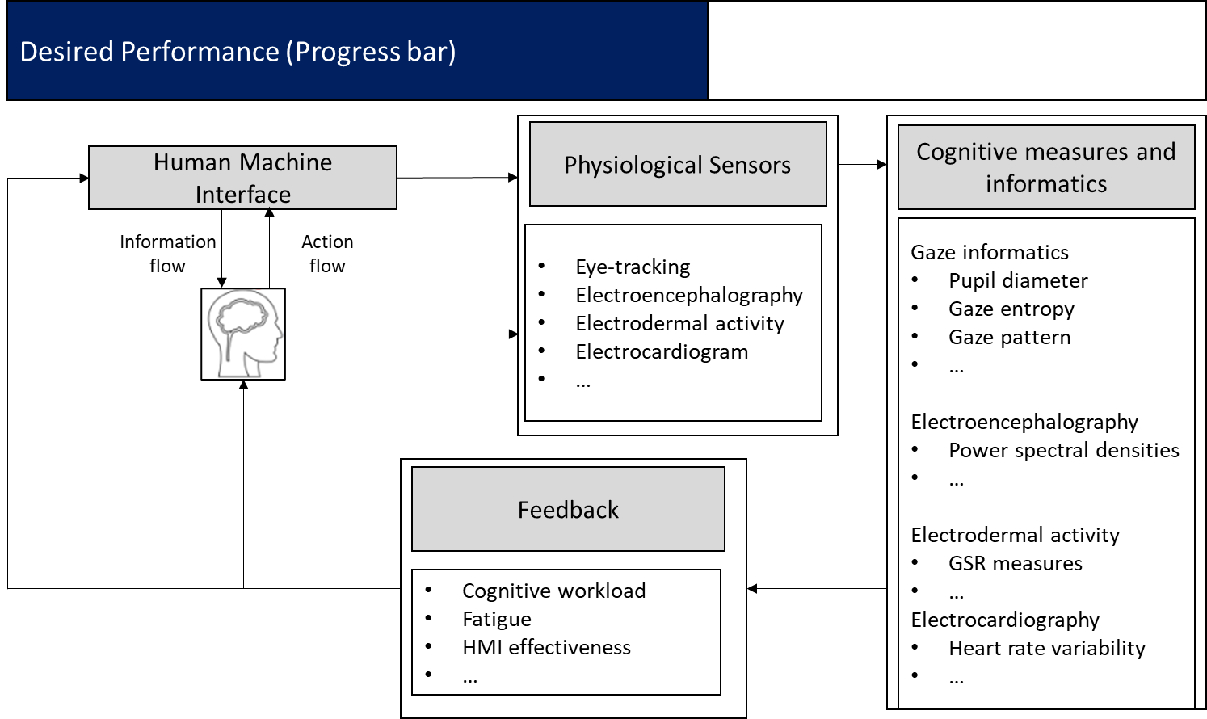
Big Picture
Aviation
Marine
Driving
Construction
Health care
Virtual/ Augmented Reality
Space Exploration
Human-Robot Interaction
Srinivasan, R., Srinivasan, B., & Iqbal, M. U. (2022). Human factors in digitalized process operations. MCPS

Slide 45
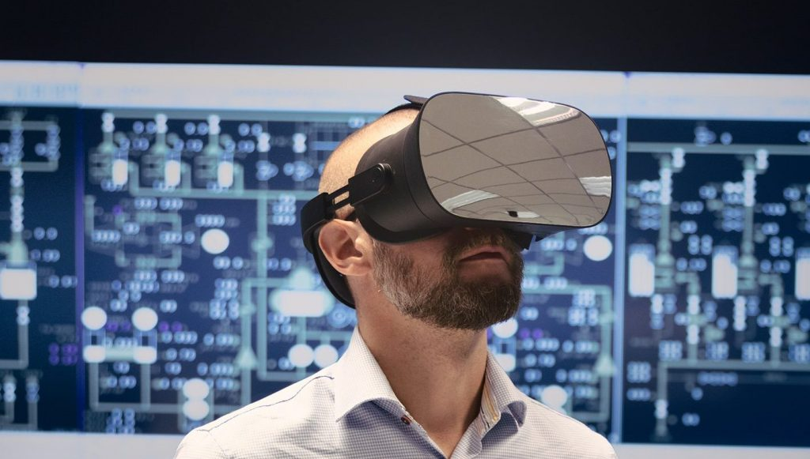
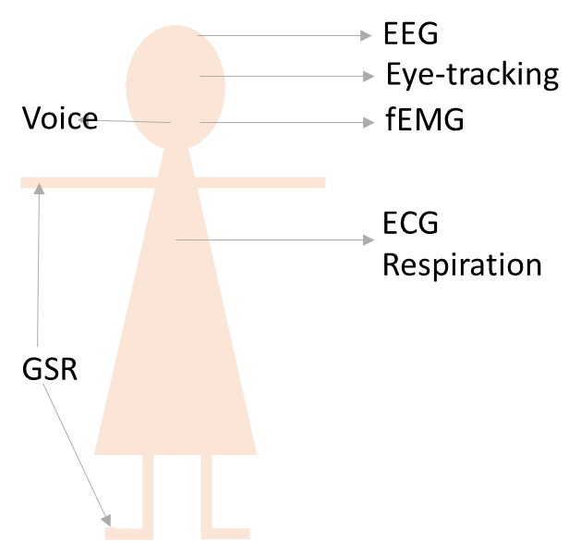
Future Work- Pictographic view
Multi modal fusion
Virtual Reality (VR)/ AR
Human Robot Collaboration
Comfort, experience, sense of presence and effectiveness
Allocation of tasks
Trust between man and machine

Slide 46
References
The presentation is based on the following studies:
Iqbal, M. U., Srinivasan, B., & Srinivasan, R. (2018). Towards obviating human errors in real-time through eye tracking. In Computer Aided Chemical Engineering (Vol. 43, pp. 1189-1194). Elsevier.
Iqbal, M. U., Srinivasan, B., & Srinivasan, R. (2020). Dynamic assessment of control room operator's cognitive workload using Electroencephalography (EEG). Computers & Chemical Engineering.
Iqbal, M. U., Shahab, M.A., Chowdhary, M., Srinivasan, B., & Srinivasan, R. (2021). Electroencephalography (EEG) based Cognitive Measures for Evaluating the Effectiveness of Operator Training. Process Safety and Environmental Protection.
Iqbal, M. U., Srinivasan, B., & Srinivasan, R. (2023). Multi-class classification of control room operators’ cognitive workload using the fusion of eye-tracking and electroencephalography. Computers & Chemical Engineering.
Srinivasan, R., Srinivasan, B., & Iqbal, M. U. (2022). Human factors in digitalized process operations. MCPS

Slide 47
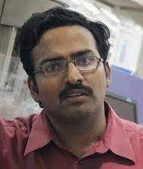
Acknowledgement
Prof. Rajagopalan Srinivasan
Chemical Engineering
IIT Madras
Head, DART Lab
Prof. Babji Srinivasan
Applied Mechanics and Biomedical Engineering
IIT Madras
Core Faculty, DART Lab
American Express Lab for Data Analytics, Risk and Technology, IIT Madras
Colleagues: Dr. Mohammad Aatif Shahab, Mahindra Choudhary

Slide 48
We cannot improve what we cannot measure
Thank you
Questions?

